Slide 1




CURA-HMS

Slide 2

AGENDA

Slide 3

Agenda
Improvements from professor feedback
Problem statement
Project description
Team working agreement
Personas
Sprint 6 Recap
Technologies
Algorithms
Product Backlog
Sprint 7 Backlog
Metrics
Retrospective
Stories Committed for Sprint 8
Project demo
Live Application
Team member roles and responsibilities
MVP
Diagrams

Slide 4



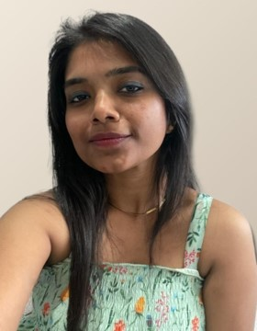
MEET OUR TEAM
SAI TEJA KORIBILLI
BINDU VALISETTY
KULDEEP KALUVALA
MOUNIKA THALLA
SCRUM MASTER
DATA BASE ADMINISTRATOR
UI/UX DEVELOPER
DEVELOPER
PROJECT MANAGER

Slide 5

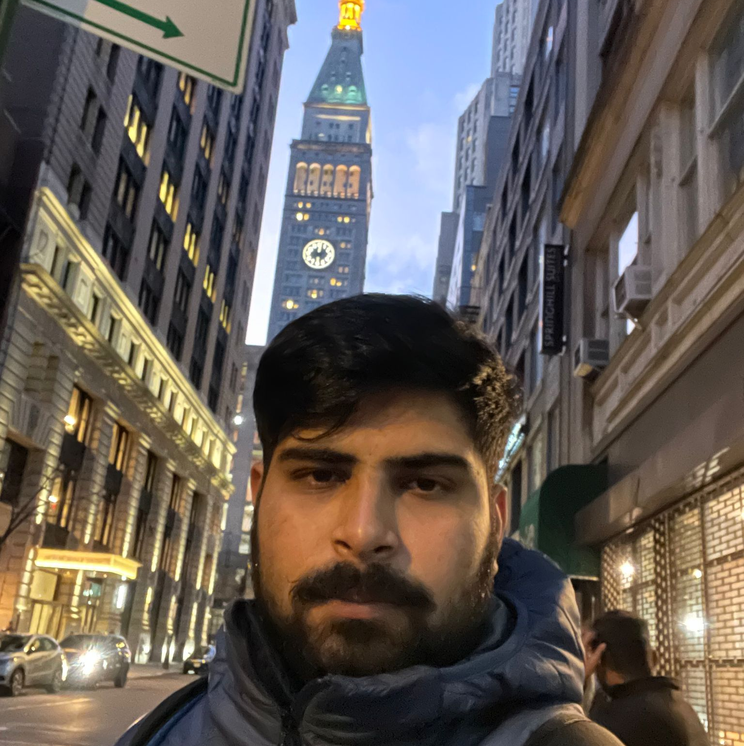

MEET OUR TEAM
SHIVANSH TOMAR
NIKHIL
JIGAR SHAH
QUALITY
ANALYST EGINEER
DEVELOPER
DEVELOPER

Slide 6
Improvements made from Professor Feedback
Feedback
Improvements
User story points should be mentioned in the Fibonacci sequence.
Updated user story points in the Fibonacci sequence as 1,2,3,5,8 and so on.

Slide 7
Problem Statement
Most hospitals are still facing several challenges with Hospital Management System because some of them are still using manual processes, while those who are using computerized method are also facing the challenge of adjusting to it. Like:
The high cost of software development and deployment.
Complex design in terms of User Interface and User Experience (UI/UX Design)
Fear of data security breach.
Difficulty in migrating from manual processes, because both staff and patients are used to the manual processes and so are unable to speedily cope with the new system.
Lack of IT-friendly medical personnel is also presenting several challenges.
A Huge influx of patients visiting government hospitals makes the process of migrating to automated processes highly difficult. They do not have the patience to wait for registration and data entry and often fail to understand the functioning of automated processes.

Slide 8
Project Description
Project Description
Project Name: | Cura HMS
Team Name: | Medical Maestros
Project Description: | CURA helps to automate routine tasks, optimize staff coordination, improve communication, distribute the workload, store different types of information, and provide financial and HR management. For patients who want to book an appointments, the CURA is a web app that provides a hassle-less to book an appointment with doctor, unlike the traditional way where we had to call or text and ask for doctor’s availability our cura app is a tool that collects data about patients, doctors, staff, hospital administrative details in one software.
Benefit Outcomes: | Patients can book appointments with particular Doctor according to their preferred date and time . Doctors can see the appointment list of patients and schedule his duties at hospital .
GitHub Wiki: | https://github.com/htmw/HMS/wiki

Slide 9
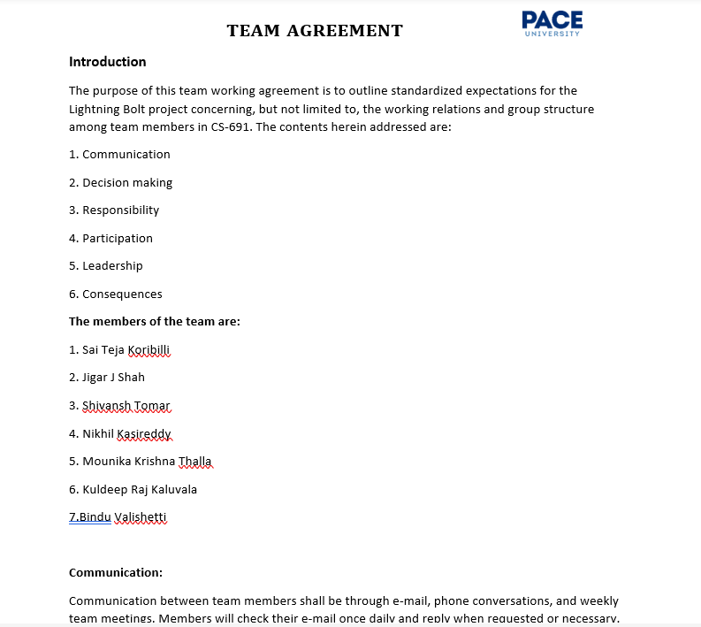
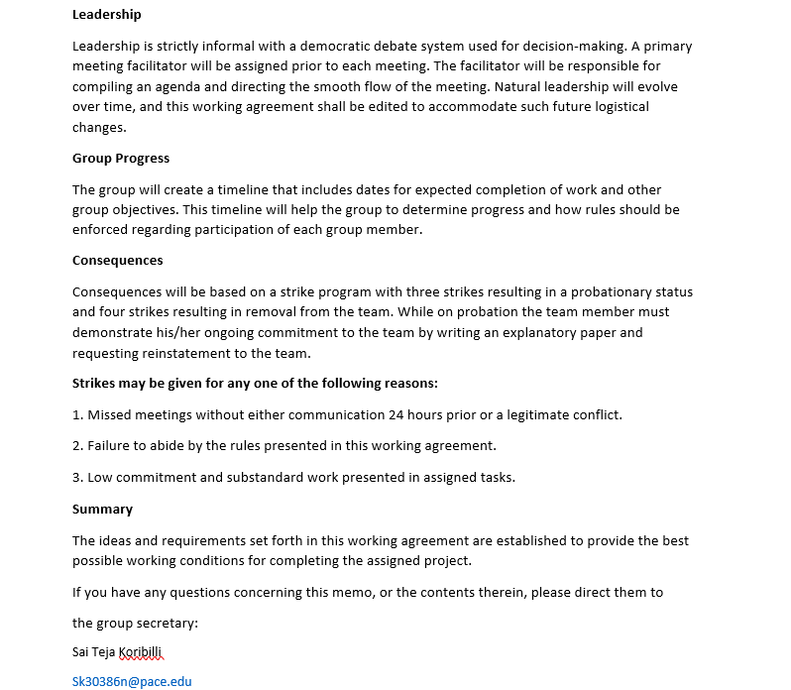
Team Working Agreement

Slide 10


Personas

Slide 11
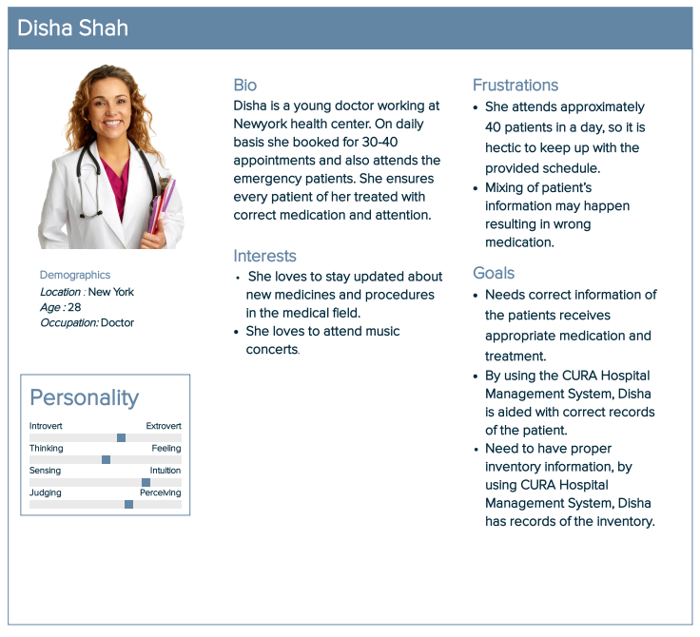
Persona 1

Slide 12
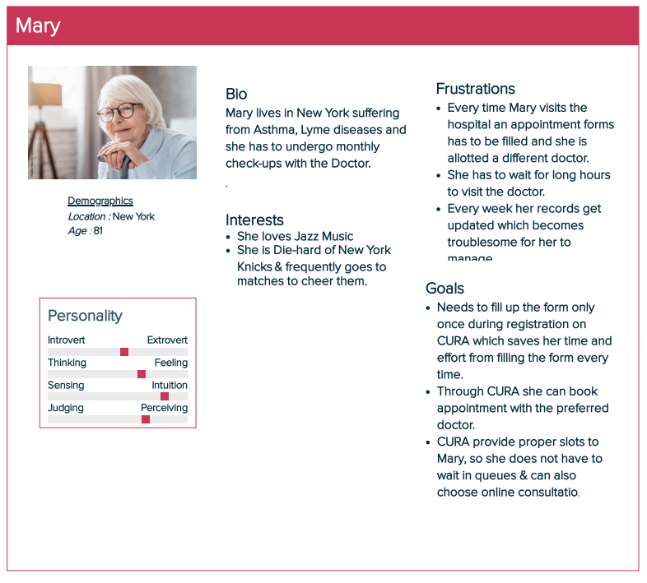
Persona 2

Slide 13
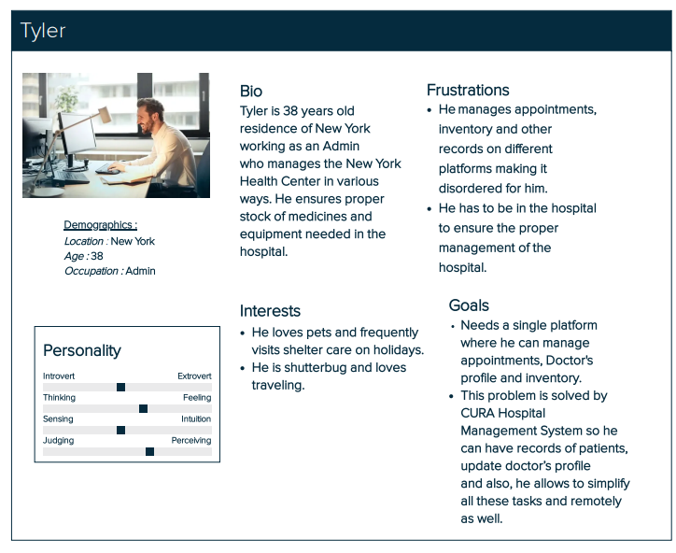
Persona 3

Slide 14


Minimum Viable Product (MVP)
Homepage
Registration
Login – Patient ,Doctor, Staff & Inventory
Scheduling duties
Appointment - booking & cancel

Slide 15









TECHNOLOGIES
FRONT END
Java Script
BACK END/ SERVER
DATABASE
TESTING
CUCUMBER
API
TOOLS

Slide 16

Algorithm
The proposed system has five modules for doctors, admin, pathologists, inventors and patients providing facilities for appointment schedules, payment, viewing online information, register on hospital website. The whole process of information sharing and processing in this system is automated through the Decision Tree ID3 algorithm
What is ID3 Algorithm?
ID3 stands for Iterative Dichotomiser 3 and is named such because the algorithm iteratively (repeatedly) dichotomizes(divides) features into two or more groups at each step.
ID3 uses a top-down greedy approach to build a decision tree. In simple words, the top-down approach means that we start building the tree from the top and the greedy approach means that at each iteration we select the best feature at the present moment to create a node. Attempts to create the smallest possible decision tree.

Slide 17
ID3 ALGORITHM
Before you inquire, the response to the question: "How does ID3 choose the best feature?" is that ID3 uses Information Gain, or simply Gain, to identify the best feature.
Information Gain determines the entropy decrease and assesses how effectively a particular feature categorizes or separates the target classes. The most effective feature is the one that has the greatest Information Gain.
Simply put, entropy is a measure of disorder, and a dataset's entropy is a measure of disorder in the feature that is being measured.
Entropy is 0 for homogeneous (similar) values in the target column in the case of binary classification (where the target column has only two types of classes), and it is 1 for equal numbers of values in the target column for both classes.

Slide 18
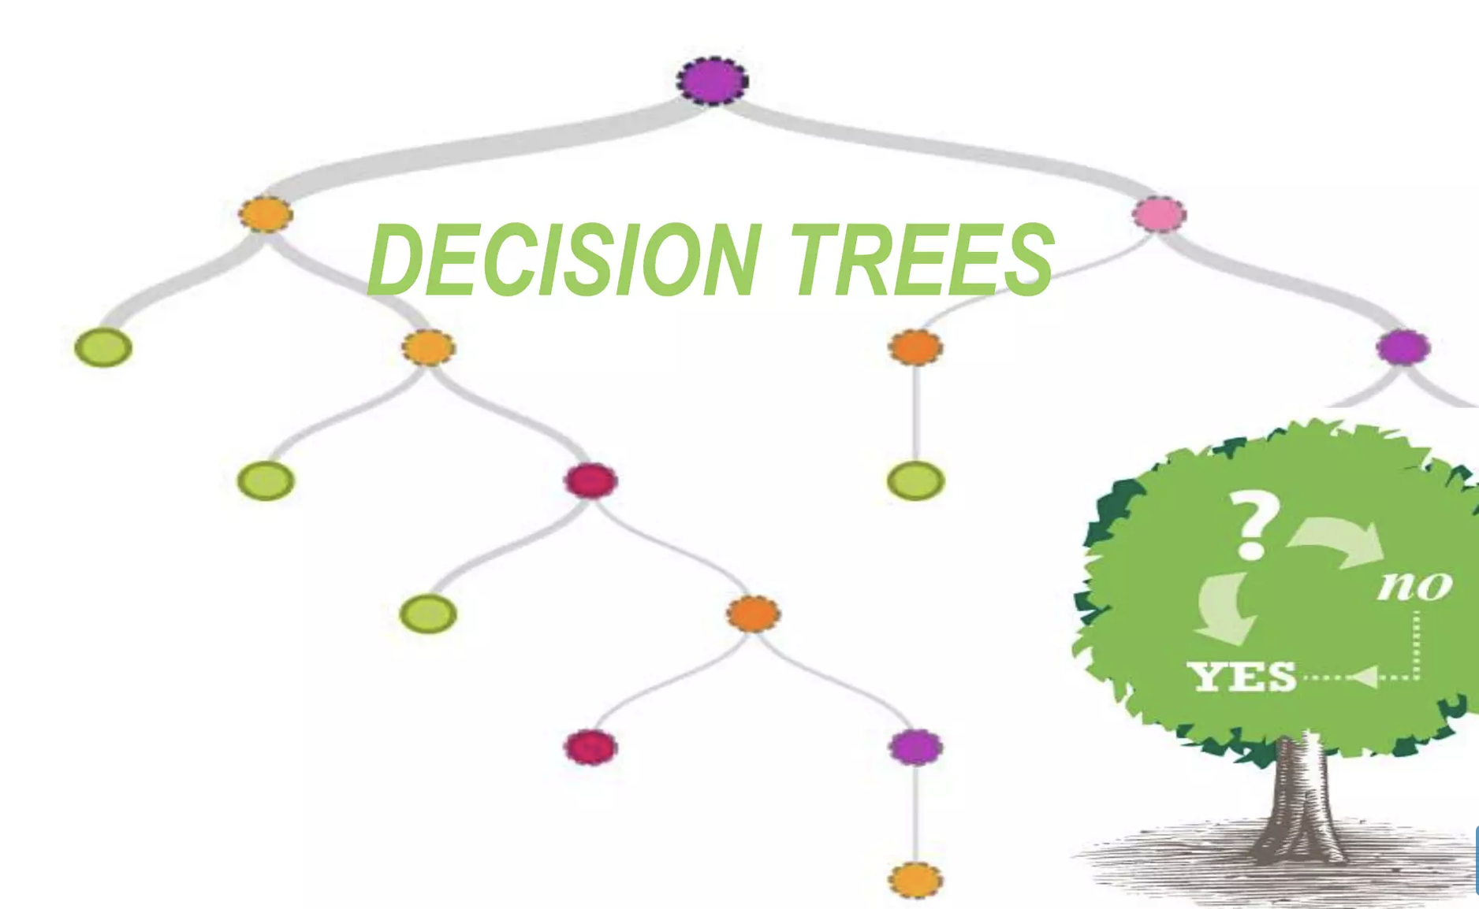
ID3 ALGORITHM
Calculate the Entropy of every attribute using the data set.
Split the set into subsets using the attribute for which entropy is minimum (or, equivalently, information gain is maximum).
﻿﻿Make a decision tree node containing that attribute.
﻿﻿Recurse on subsets using remaining attributes.

Slide 19

Diagrams

Slide 20
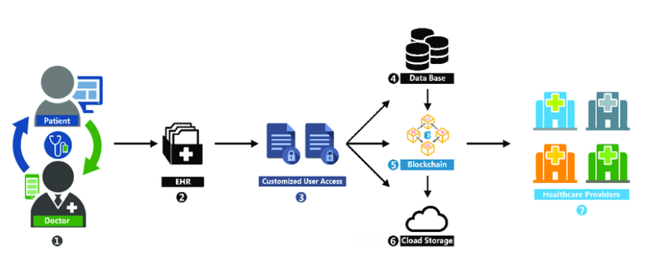

CONCEPTUL ARCHITECURE DIAGRAM

Slide 21
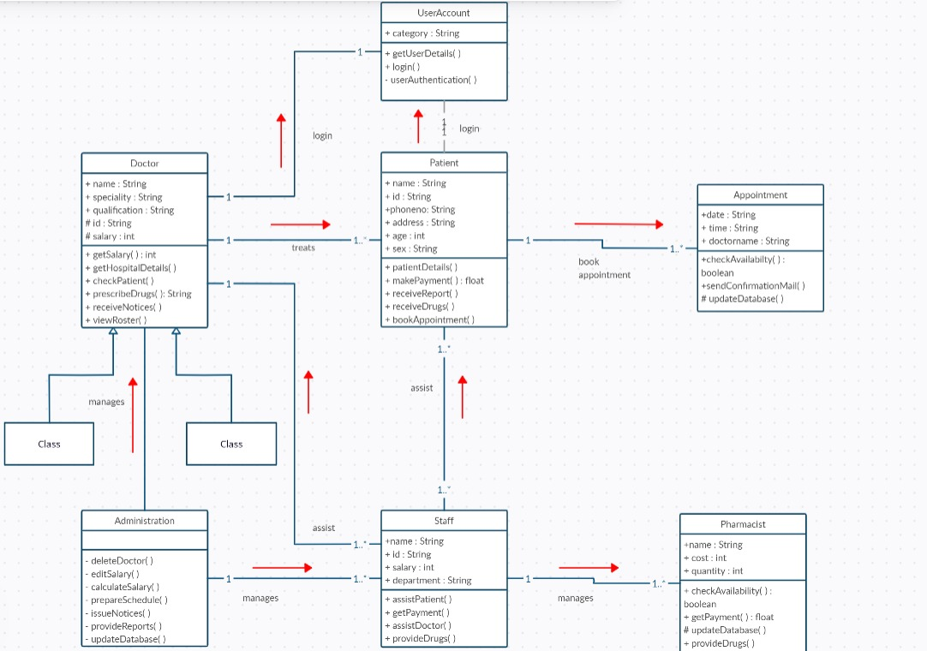
CLASS DIAGRAM
OF
CURA

Slide 22
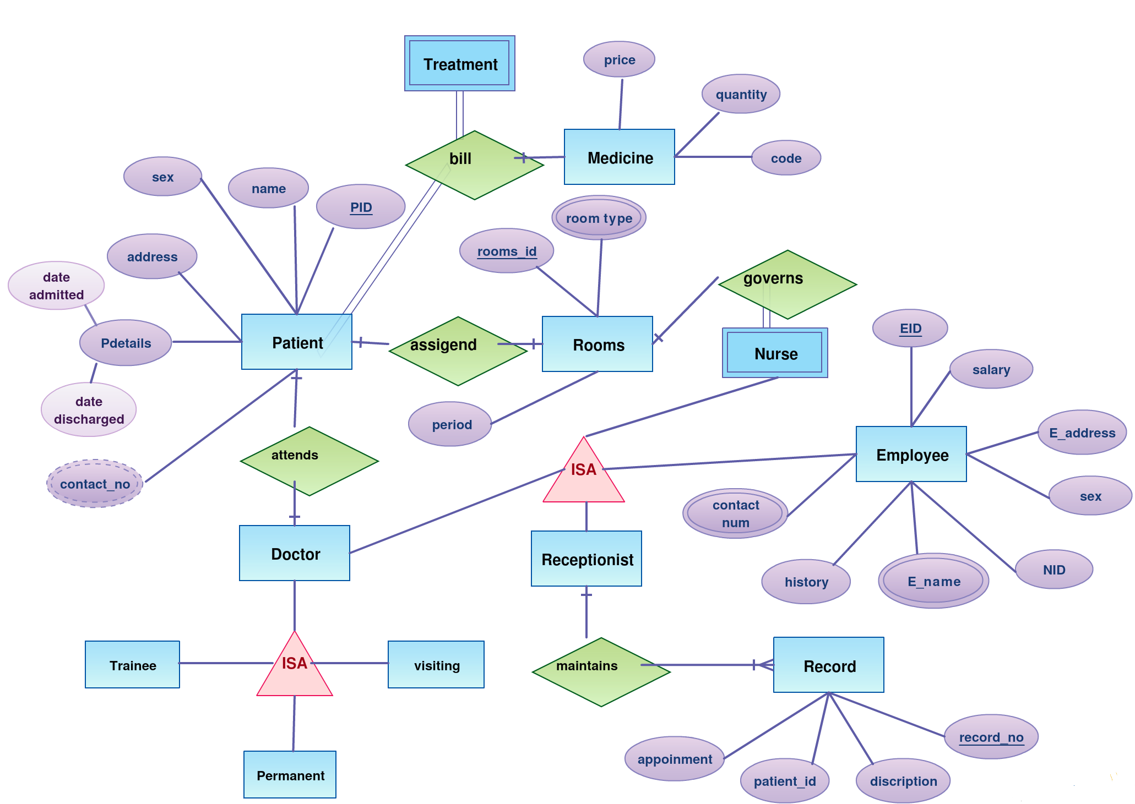
ER DIAGRAM

Slide 23
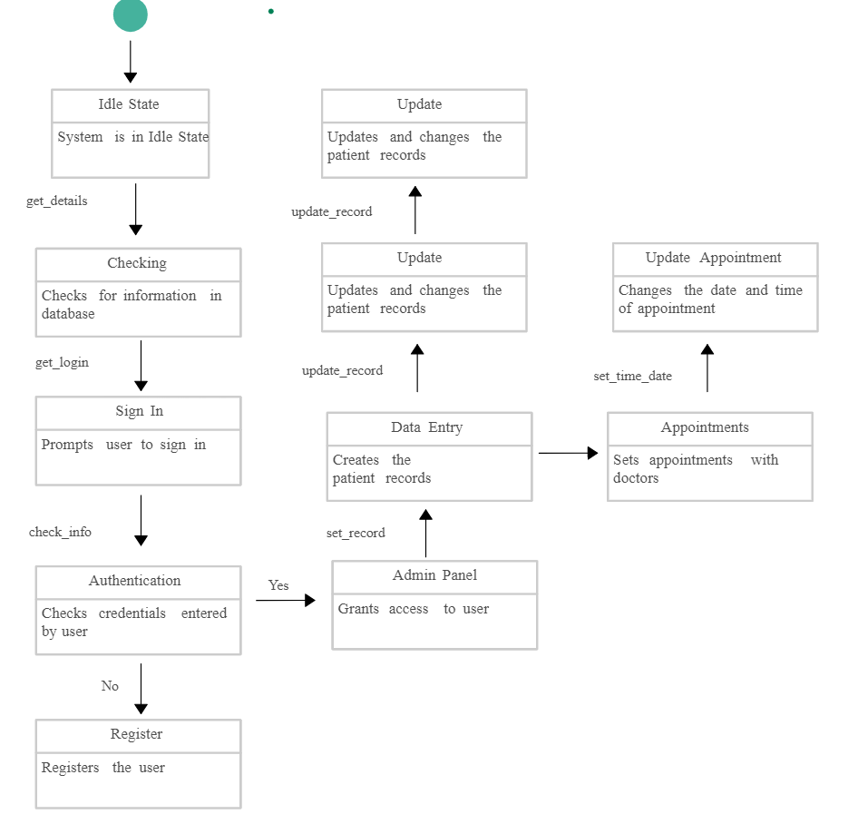
STATE DIAGRAM

Slide 24
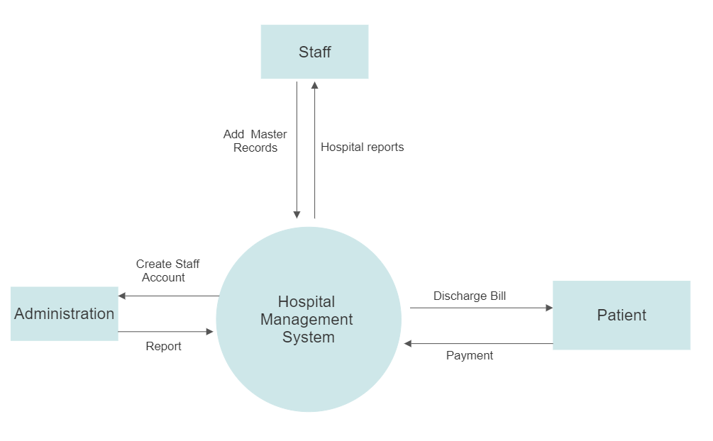
Dataflow
Diagram
Level 0

Slide 25

SPRINT 6 RECAP
surfing through the options according to the role of the person using the application.
Submission updates and confirmation about the same
Appointments confirmation from the patients’ end in the portal
Uploading necessary information access for a pathologist

Slide 26

PRODUCT BACKLOG

Slide 27
Product Backlog
Issue Type | ID | Summary | Status | Story Points | Priority
Story | CURA-30 | As a Patient, I want to confirm whether my appointment with the doctor is set up or no so that I can have an idea about my appointment with doctor. | Done | 5 | High
Story | CURA-32 | As an Inventor, I want to know whether the supplies are as per the requirement or no, so that I can re-stock them. | Done | 3 | Medium
Story | CURA-33 | As a Pathologist, I want to know whether samples of the patient are correctly entered or no, so that there is no confusion with patient's details with others. | Done | 2 | Low
Story | CURA-34 | As an Admin, I want to navigate to doctor/staff/nurse section to check the log-in time so that I can verify whether every doctor/nurse/staff is attending the hospital on time. | Done | 5 | High
Story | CURA-36 | As a Staff, I want to check room availability and manage rooms according to requirements so that it will be very helpful to doctors. | To-do | 3 | Medium

Slide 28
Product Backlog
Issue Type | ID | Summary | Status | Story Points | Priority
Story | CURA-35 | As an Admin can add doctors, add staff, view the details, and can also modify them. | Done | 5 | High
Story | CURA-29 | As a Doctor, I want to see my particulars/schedule/profile on the application so that I can plan my duties at hospital . | Done | 3 | Medium
Story | CURA-31 | As a Patient, I want to submit my symptoms/previous history documents in the portal for assessment so that I may receive an accurate determination | Done | 5 | High
Story | CURA-37 | As a Pathologist, I want to upload patient test results in the portal so that it will be easy to check reports for Doctors before the patient’s appointment. | Done | 3 | Medium
Story | CURA-38 | As a nurse, I want to write prescriptions for the patients as directed by the doctor and can also upload prescription documents also. | To-do | 3 | Medium
Story | CURA-39 | As a nurse, I want to see the prescriptions given by the doctor to the patients through the nurse portal. | Done | 2 | Low

Slide 29
SPRINT 7 BACKLOG

Slide 30
Sprint 7 Backlog
User Story Id | Summary | Story Points Estimate
CURA-29 | As a Doctor, I want to see my particulars/schedule/profile on the application so that I can plan my duties at the hospital. | 3
CURA-34 | As an Admin, I want to navigate to doctor/staff/nurse section to check the log-in time so that I can verify whether every doctor/nurse/staff is attending the hospital on time. | 5
CURA-39 | As a nurse, I want to see the prescriptions given by the doctor to the patients through the nurse portal. | 3
CURA-32 | As an Inventor, I want to know whether the supplies are as per the requirement or not so that I can re-stock them. | 3

Slide 31
User Stories &Acceptance criteria

Slide 32
User Stories & Acceptance Criteria
User Story ID | Summary | Status
CURA-31 | As a Doctor, I want to see my particulars/schedule/profile on the application so that I can plan my duties at the hospital. | Done
 | Scenario: The doctor wants to check his schedule at the hospital Given I logged in as a Doctor When I open the application and go to this page then see the appointment list of patients and see the page to see their previous history & symptoms.
CURA-30 | As an Inventor, I want to know whether the supplies are as per the requirement or not so that I can re-stock them. | Done
 | Scenario: An Inventor wants to check the supplies at the hospital Given I logged in as an Inventor When I open the application and go to this page then see the inventory supply details page, clicking on the page I should be able to see all the inventory details and the option to restock.
CURA-33 | As an Admin, I want to navigate to the doctor/staff/nurse section to check the log-in time so that I can verify whether every doctor/nurse/staff is attending the hospital on time. | Done
 | Scenario: Admin wants to check all user’s log-in & log-out times Given I am in the role of logged-in Admin When I open the portal then in the system, I can check the total hour a doctor/staff/nurse spends seeing patients And also verify the doctor/staff/nurse's time.
CURA-37 | As a nurse, I want to see the prescriptions given by the doctor to the patients through the nurse portal. | Done
 | Scenario: Nurse wants to check the prescriptions of patients Given I'm in the role of Nurse or logged in as the nurse When I open the web application then see the prescriptions tab and click on it and verify them in the portal.

Slide 33

TEST CASES

Slide 34
Test Cases
Test ID | User Story ID | Test Case | Current State | Test Data | steps to follow | Excepted Result
TS-29 | CURA-29 | loading appointment details | user login into the application as a doctor | email:-aabc@gmail.com | doctors->schedules | user should be able to see his schedules and appointmnet details
TS-34 | CURA-34 | navigate to nurse | admin logged into application | email:-aabc@gmail.com | admin->nurse-section | admin should be able to navigate to nurse section to check the in and out times
TS-35 | CURA-34 | navigate to doctor | admin logged into application | email:-aabc@gmail.com | admin->doctor-section | admin should be able to navigate to doctor section to check the in and out times
TS-36 | CURA-34 | navigate to staff | admin logged into application | email:-aabc@gmail.com | admin->staff-section | admin should be able to navigate to staff section to check the in and out times
TS-39 | CURA-39 | loading appointment details | user logged into application as nurse | email:-aabc@gmail.com | nurse->profile | user should be able to see the prescription of the patient give by the doctor in the portal
TS-42 | CURA-32 | order supply stock | user logged into application as inventor | email:-aabc@gmail.com | inventor->supply | user should be able to see all inventory supply details

Slide 35
Test Cases
Test ID | User Story ID | Test Case | Current State | Test Data | Steps To Follow | Expected Results
TS-30 | CURA – 30 | Loading Appointment Details Page | User Login Into The Application As a Patient | Email:- aabc@cura.com Pswd:- abc | Patients -> Appointments | User should be able to see his appoinment details
TS-31 | CURA-31 | Uploading Patient Details Page | User Login Into The Application As a Patient | Email:- aabc@cura.com Pswd:- abc | Patients -> Symptoms | User should be able to upload His previous Documents and symptoms details
TS-32 | CURA-33 | Loading Patient Test Sample Data Details Page | User Login Into The Application As a Pathologist | Email:- aabc@cura.com Pswd:- abc | Pathologist -> Sample Test Data | User should be able to see all patients test data for examining
TS-33 | CURA-37 | Uploading Patient Test Results Data | User Login Into The Application As a Pathologist | Email:- aabc@cura.com Pwd:- abc | Pathologist -> Test Results Data | User should be able to Upload patient test results before doctors appointment

Slide 36
Stories Completed and Stories Not CompleteD
User Story Id | Summary | Story Points Estimate | Status
CURA-29 | As a Doctor, I want to see my particulars/schedule/profile on the application so that I can plan my duties at the hospital. | 3 | Done
CURA-34 | As an Admin, I want to navigate to the doctor/staff/ section to check the log-in time so that I can verify whether every doctor/staff is attending the hospital on time. | 5 | Done
CURA-39 | As a nurse, I want to see the prescriptions given by the doctor to the patients through the nurse portal. | 3 | Done
CURA-32 | As an Inventor, I want to know whether the supplies are as per the requirement or not so that I can re-stock them. | 3 | Done

Slide 37

METRICS

Slide 38
Team Velocity

Slide 39
Burndown chart

Slide 40
COMMITTED/ COMPLETED
RATIO

Slide 41

Retrospective

Slide 42
What went well??
Well defined and allocated tasks were made at the start of the sprint. We communicated with each other frequently about the progress of our work.
In This sprint, planning process was so good that we did what we wanted to accomplish and what each team member would be focusing on.
Transparency, common goals and unity grew in the team because of the transparency, and open discussions about how to get better as a unit.

Slide 43
What didn’t go well??
It's crucial to practice effective time management, knowledge sharing among team members
The critical technical challenges are delayed to handle, which deviated us from maintaining sprint timelines.
We had to make some last-minute bug fixes because our testing process was not as effective as we had hoped.
Frontend and backend code fusion has proven to be challenging for us, since we were not satisfied with our UI earlier..

Slide 44
What needs improvement?
Involving QA earlier in the development process will help us improve our testing procedure.
Reducing the amount of time a task is dependent on one or more people
Plan ahead and take into account a more manageable weekly tasks
Should be able to articulate the User Stories clearly.

Slide 45
Stories Planned and Committed for Sprint 8
User Story Id | Summary | Status
CURA- 38 | As a nurse, I want to write prescriptions for the patients as directed by the doctor and can also upload prescription documents also. | To-do
CURA - 36 | As a Staff, I want to check room availability and manage rooms according to requirement so that it will be very helpful to doctors | To-do

Slide 46

Application Screenshots

Slide 47
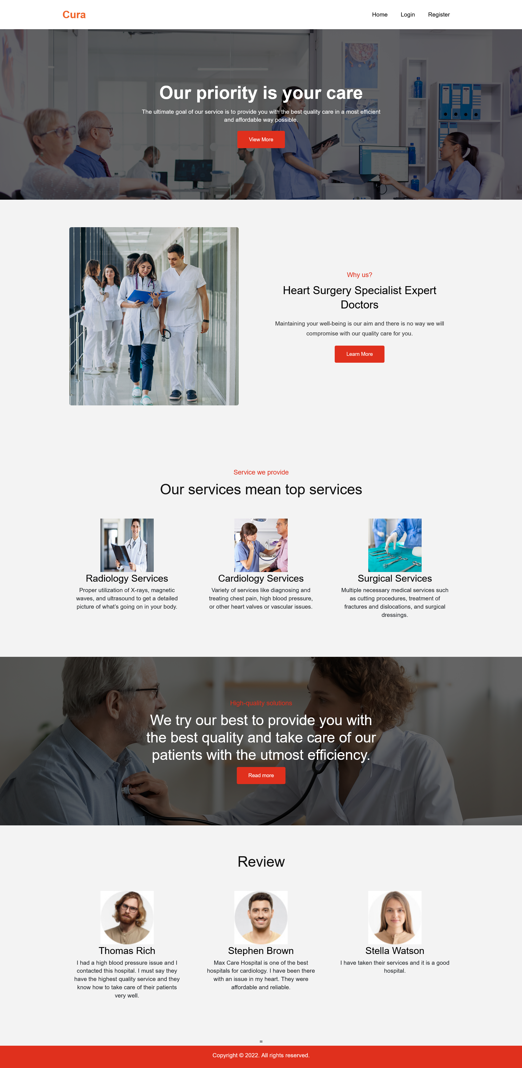
HOME PAGE

Slide 48
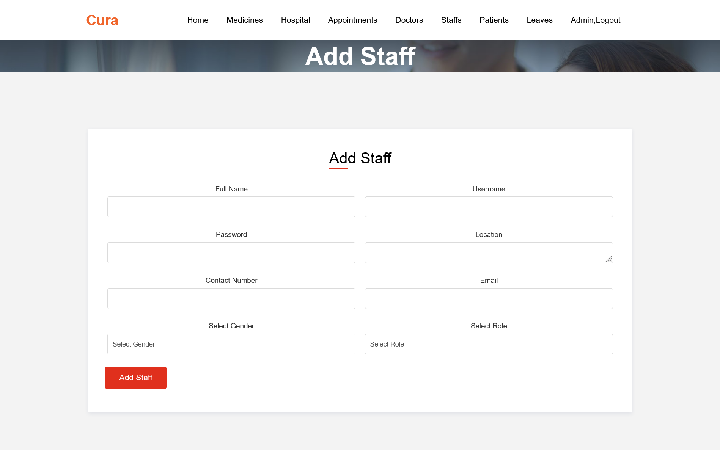
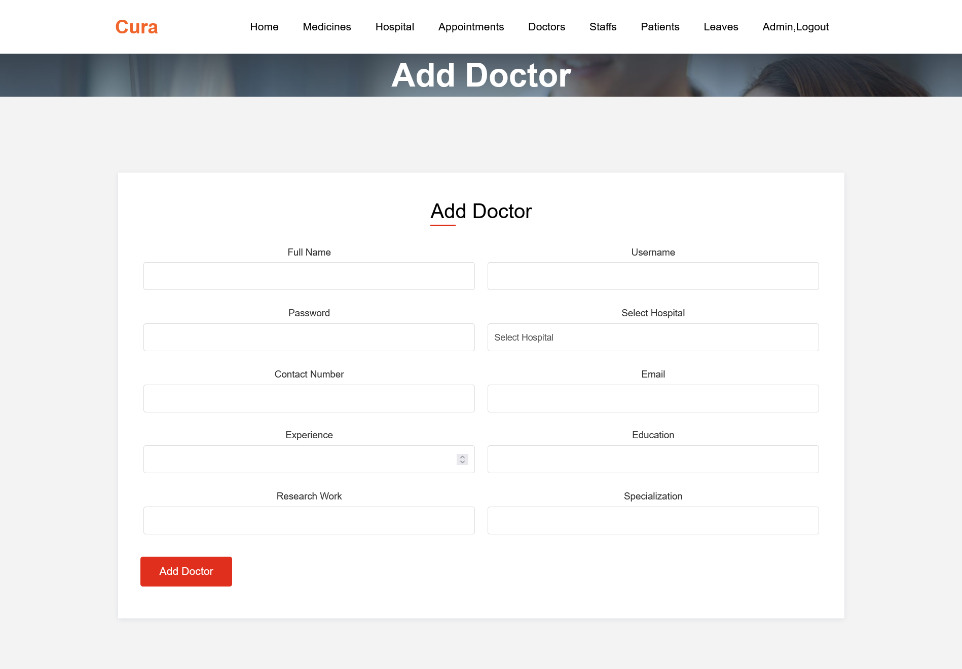
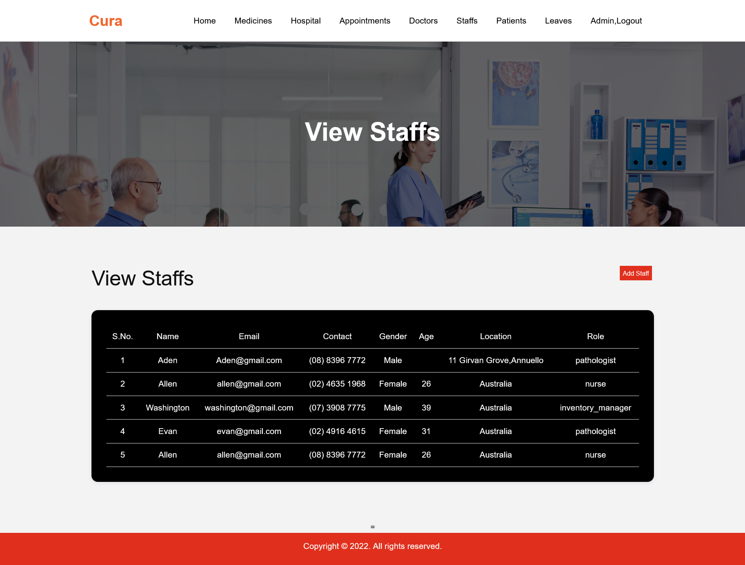
ADMIN PANEL

Slide 49
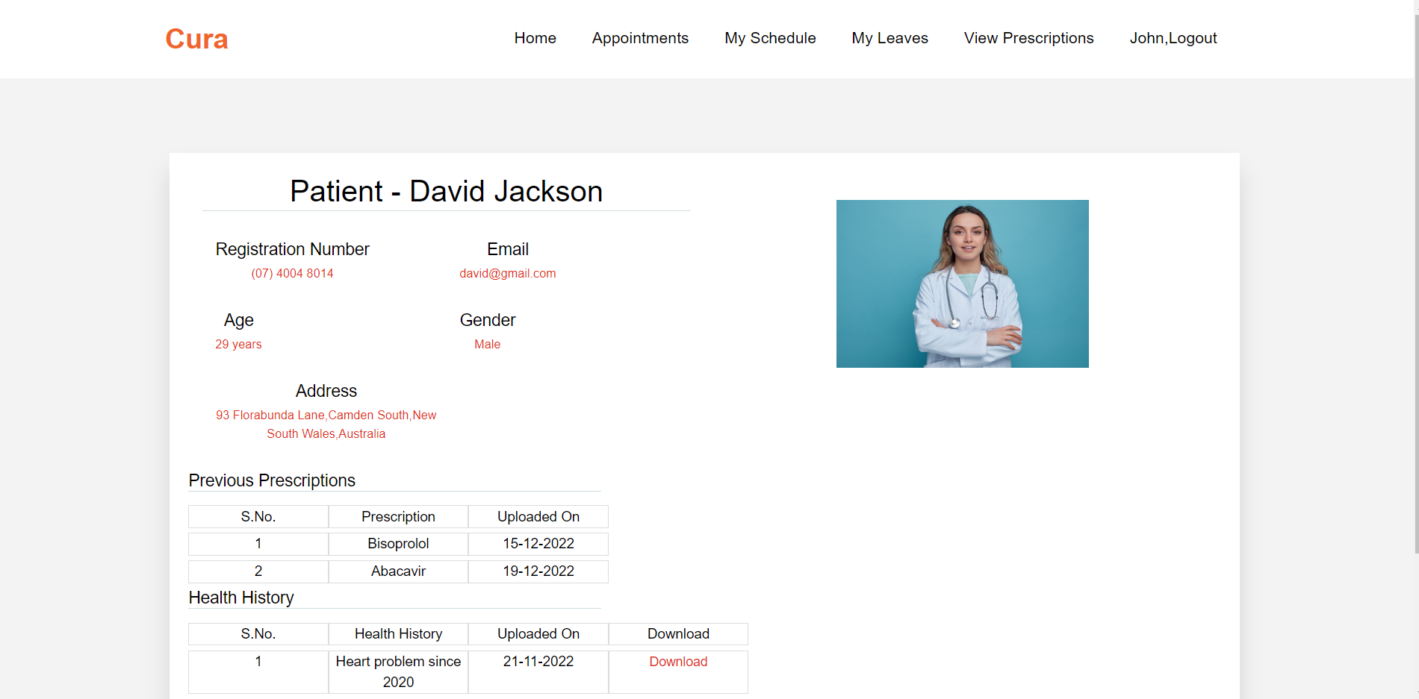
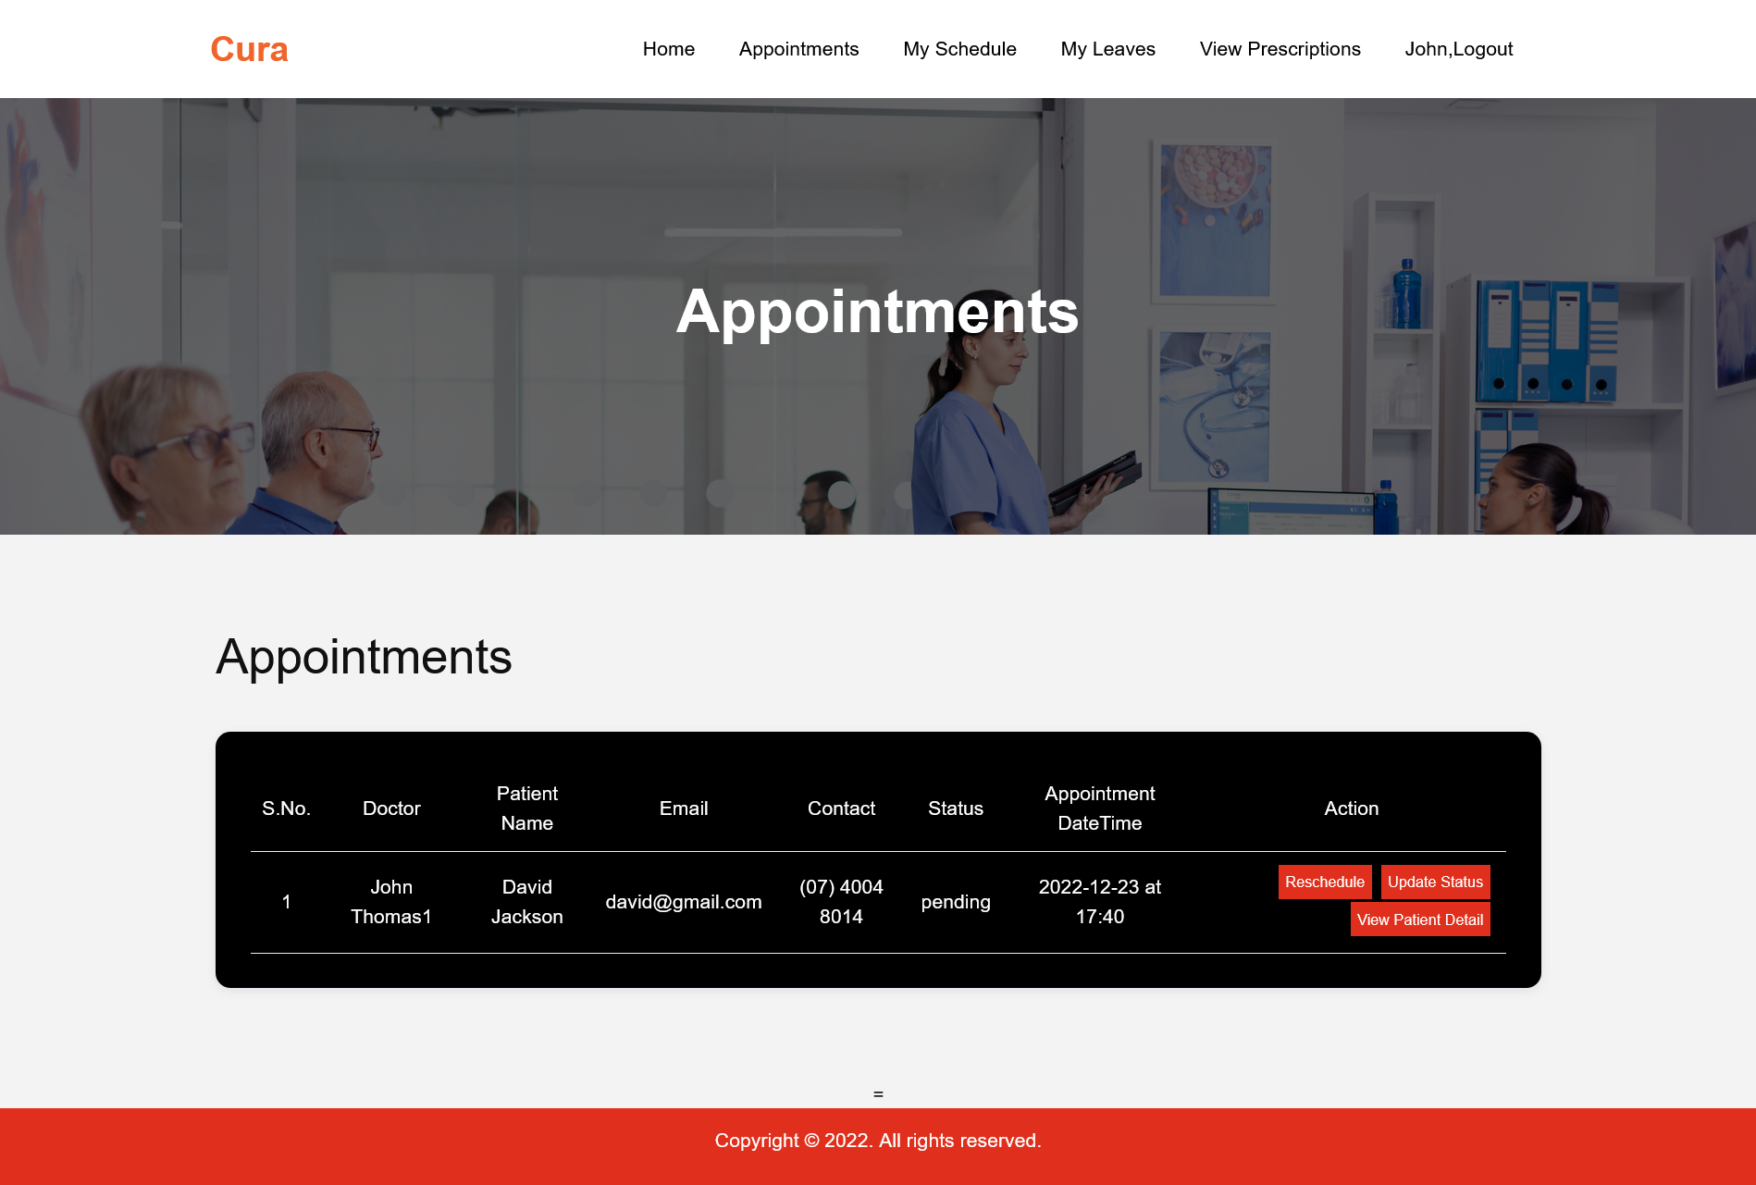
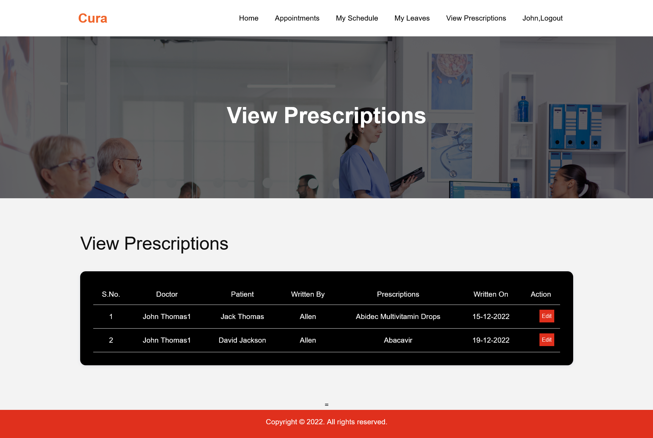
Doctor PANEL

Slide 50
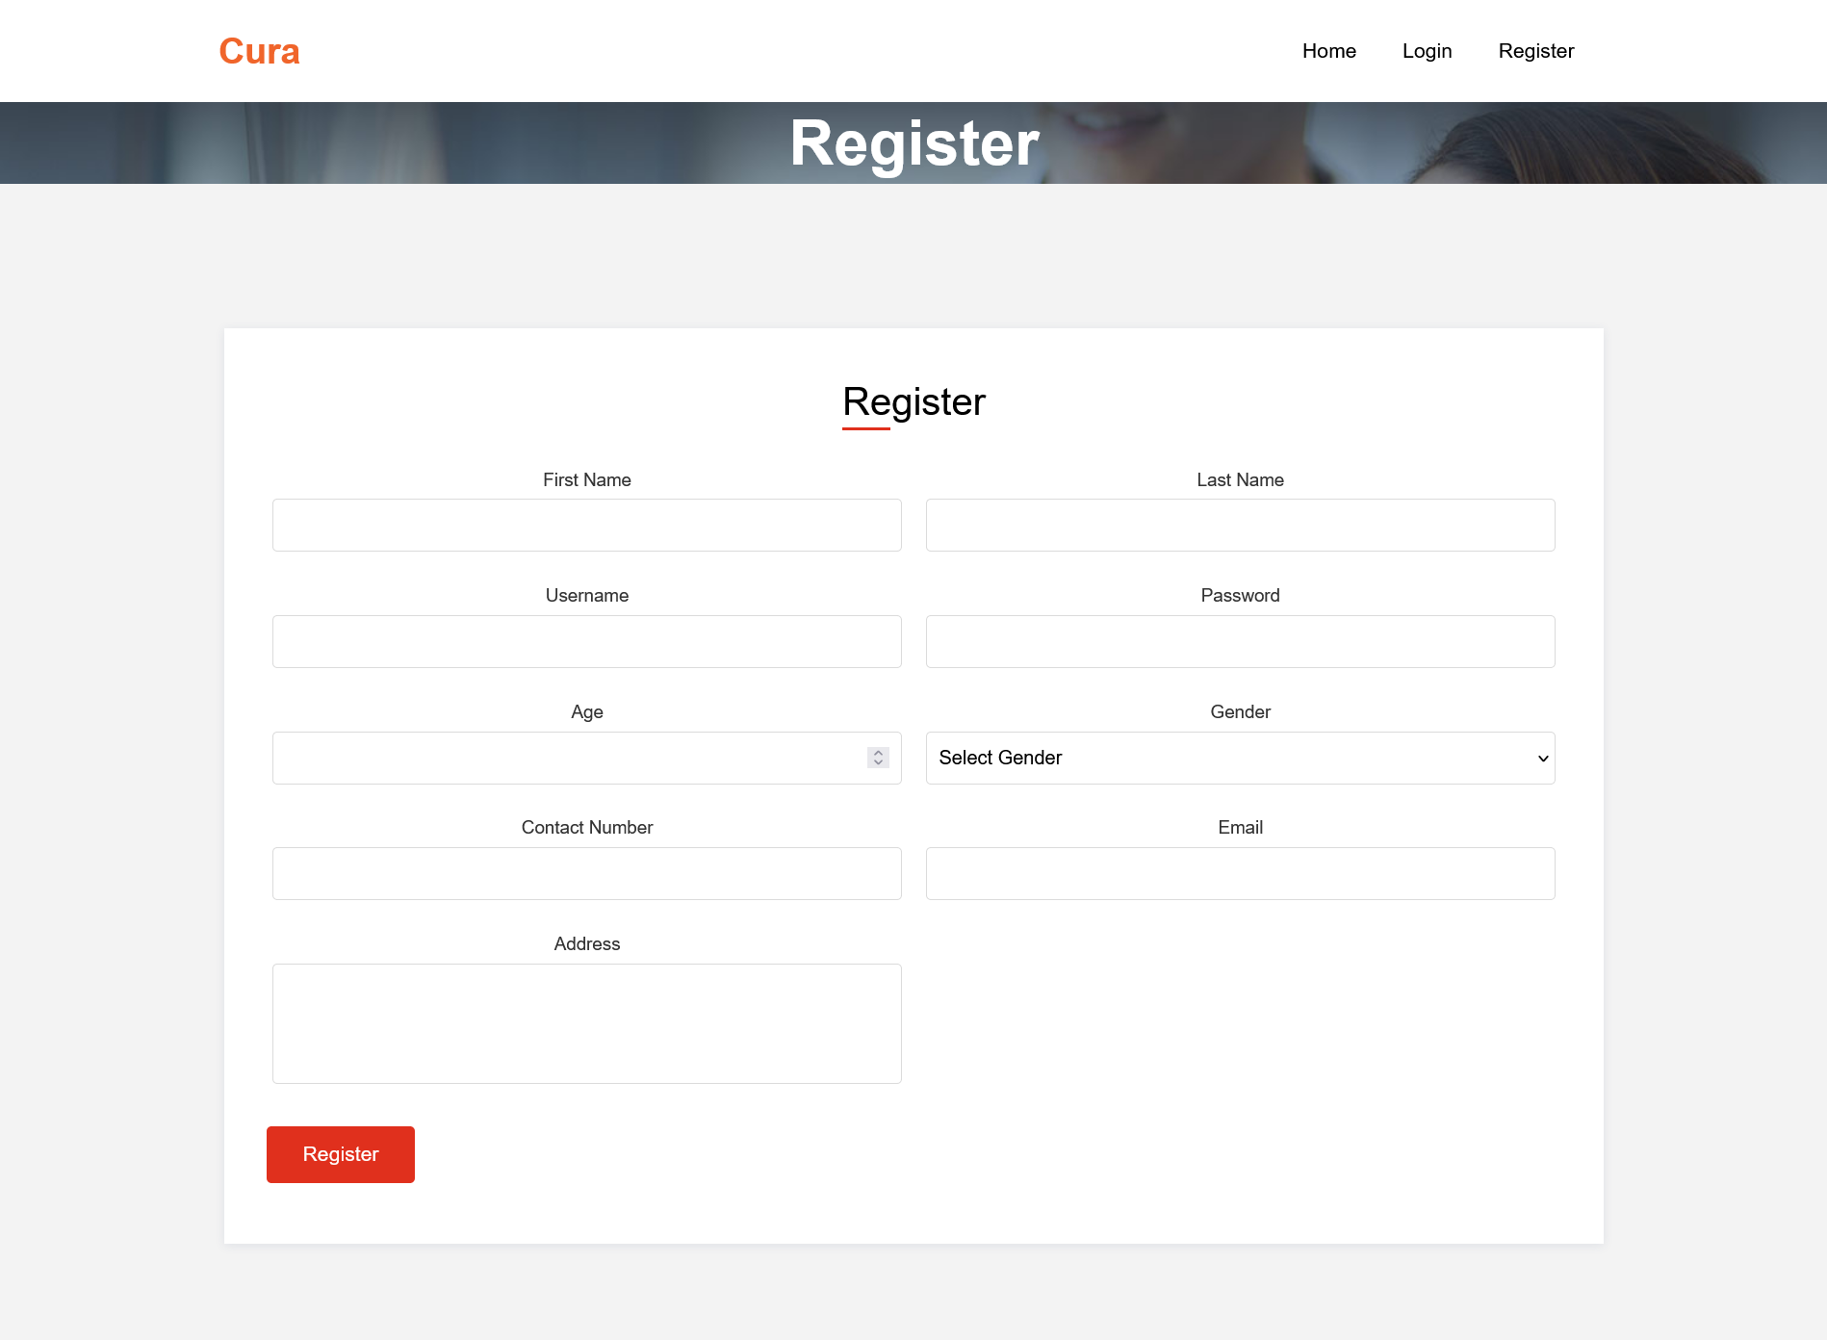
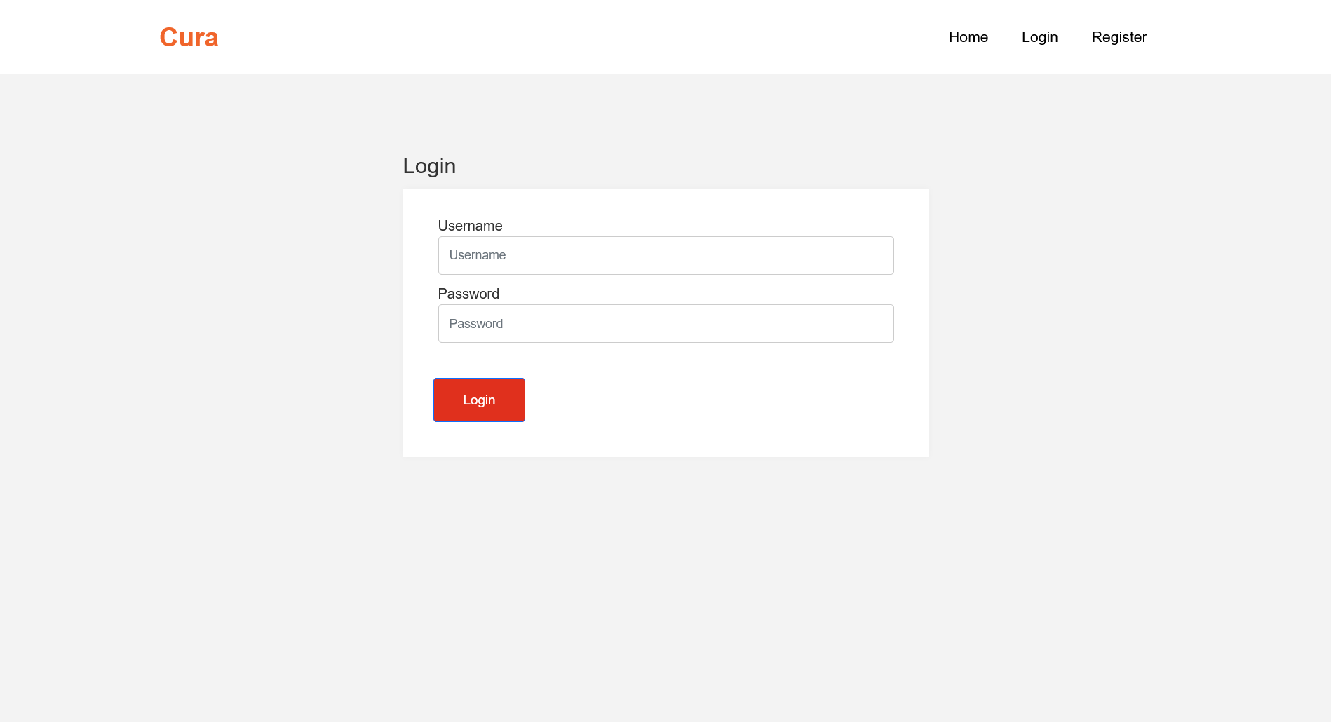
Register & Login Screen

Slide 51
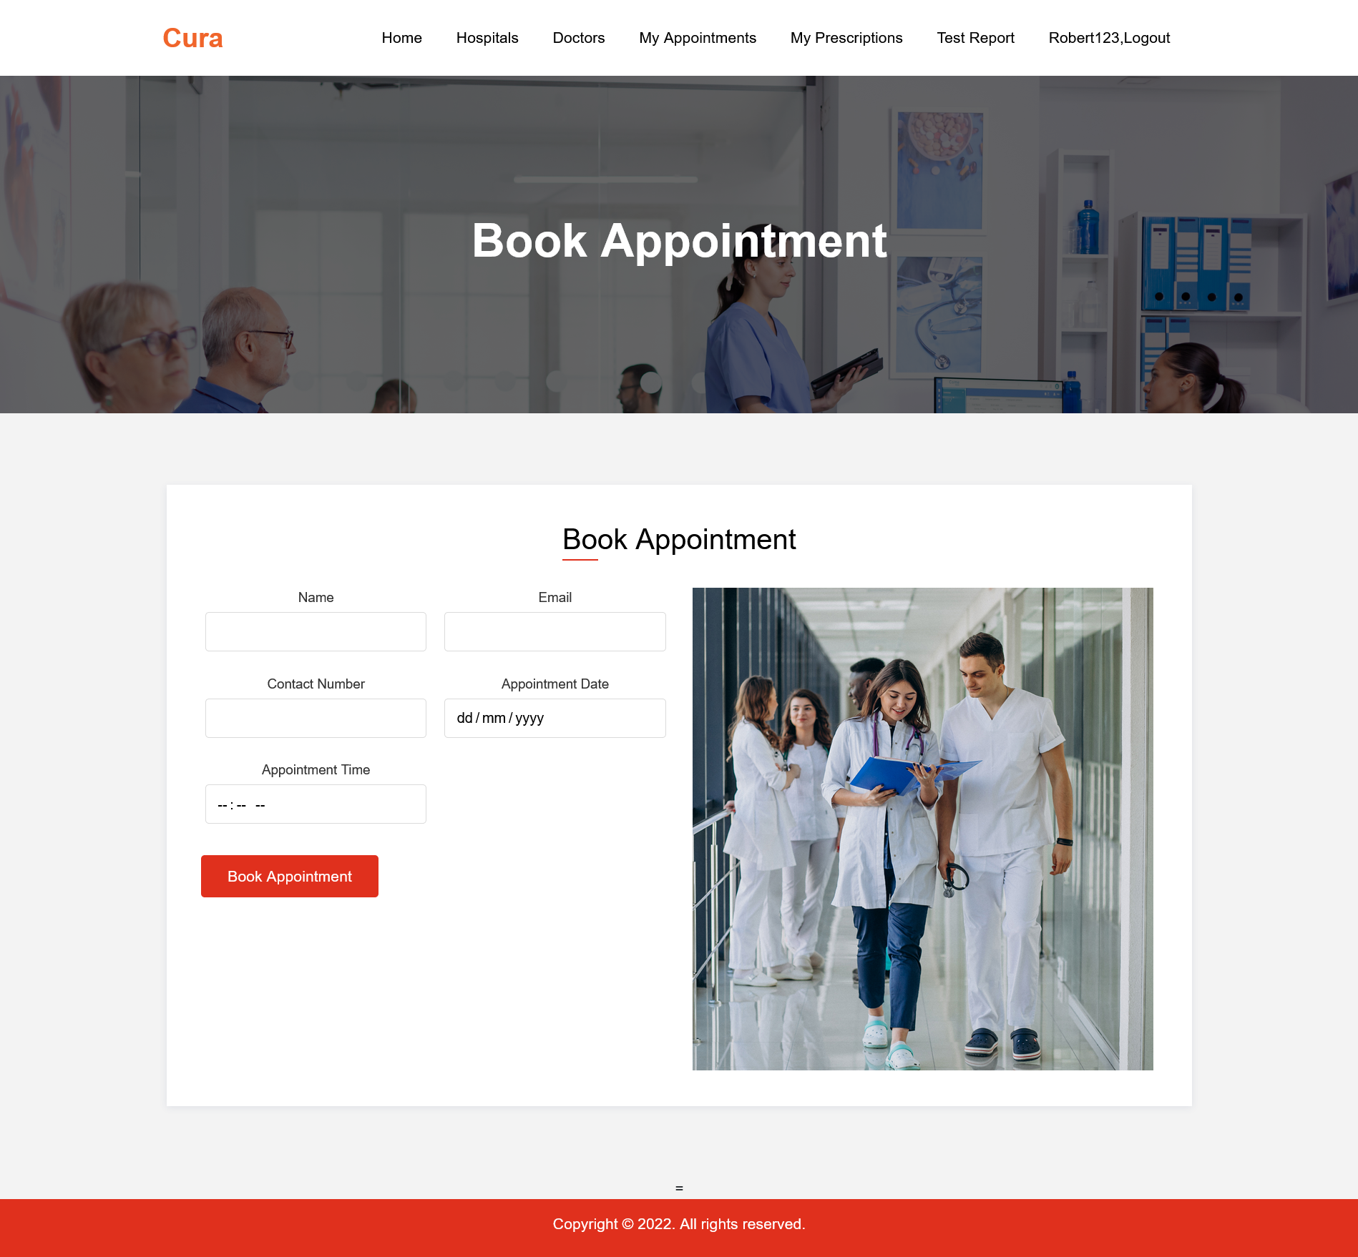
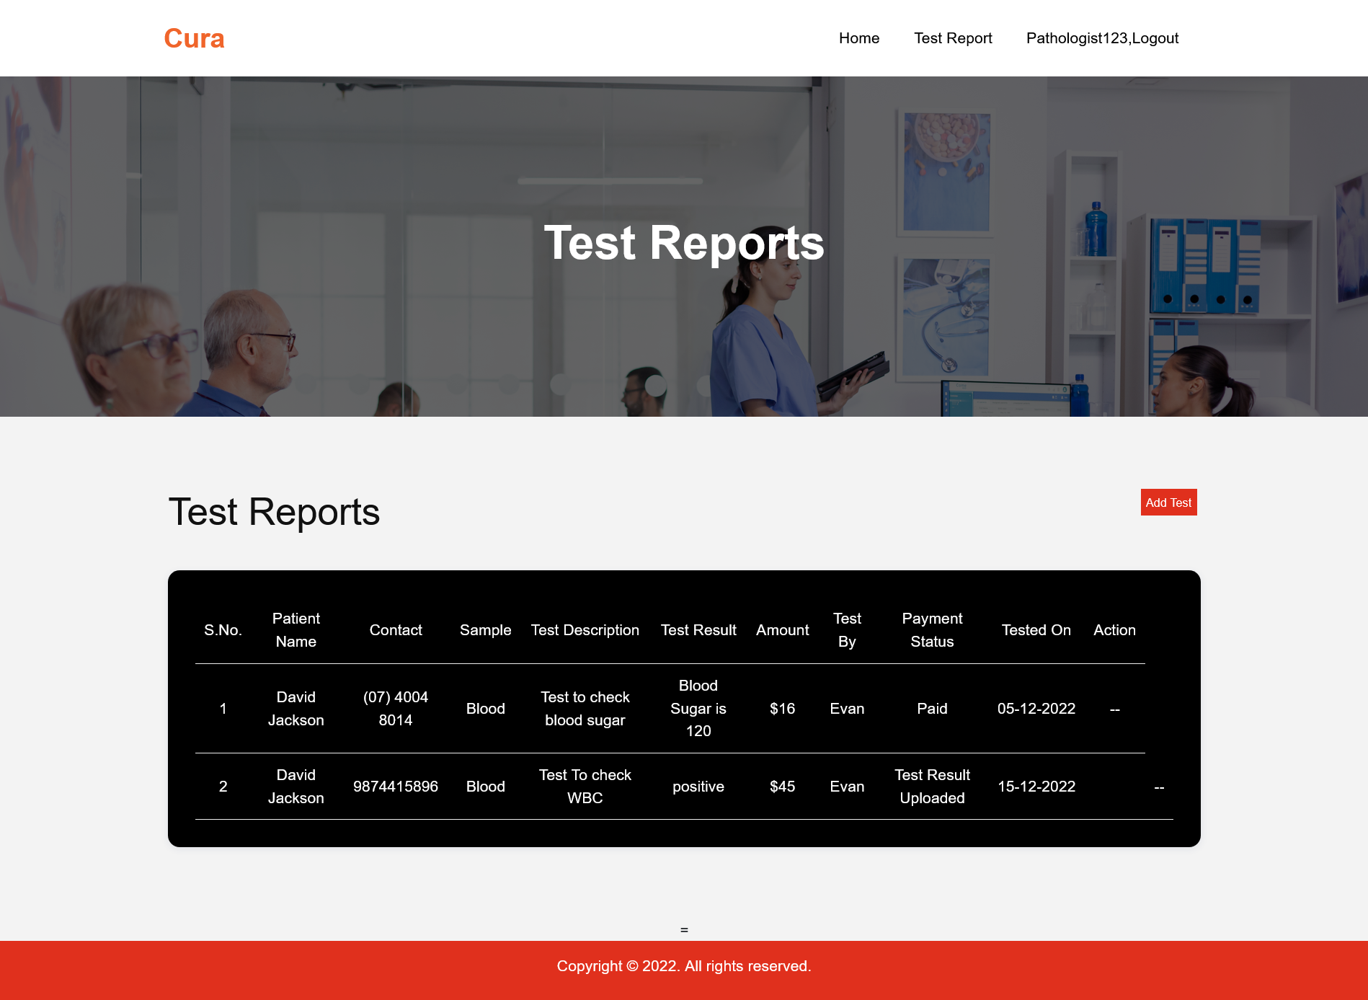
Appointment Screen

Slide 52

GITHUB LINK
https://github.com/htmw/HMS/wiki

Slide 53

THANK YOU
Sai Teja Koribilli
Jigar Shah
Mounika Thalla
Kuldeep Raj
Bindu Valishetti
Nikhil
Shivansh Tomar

